Slide 1
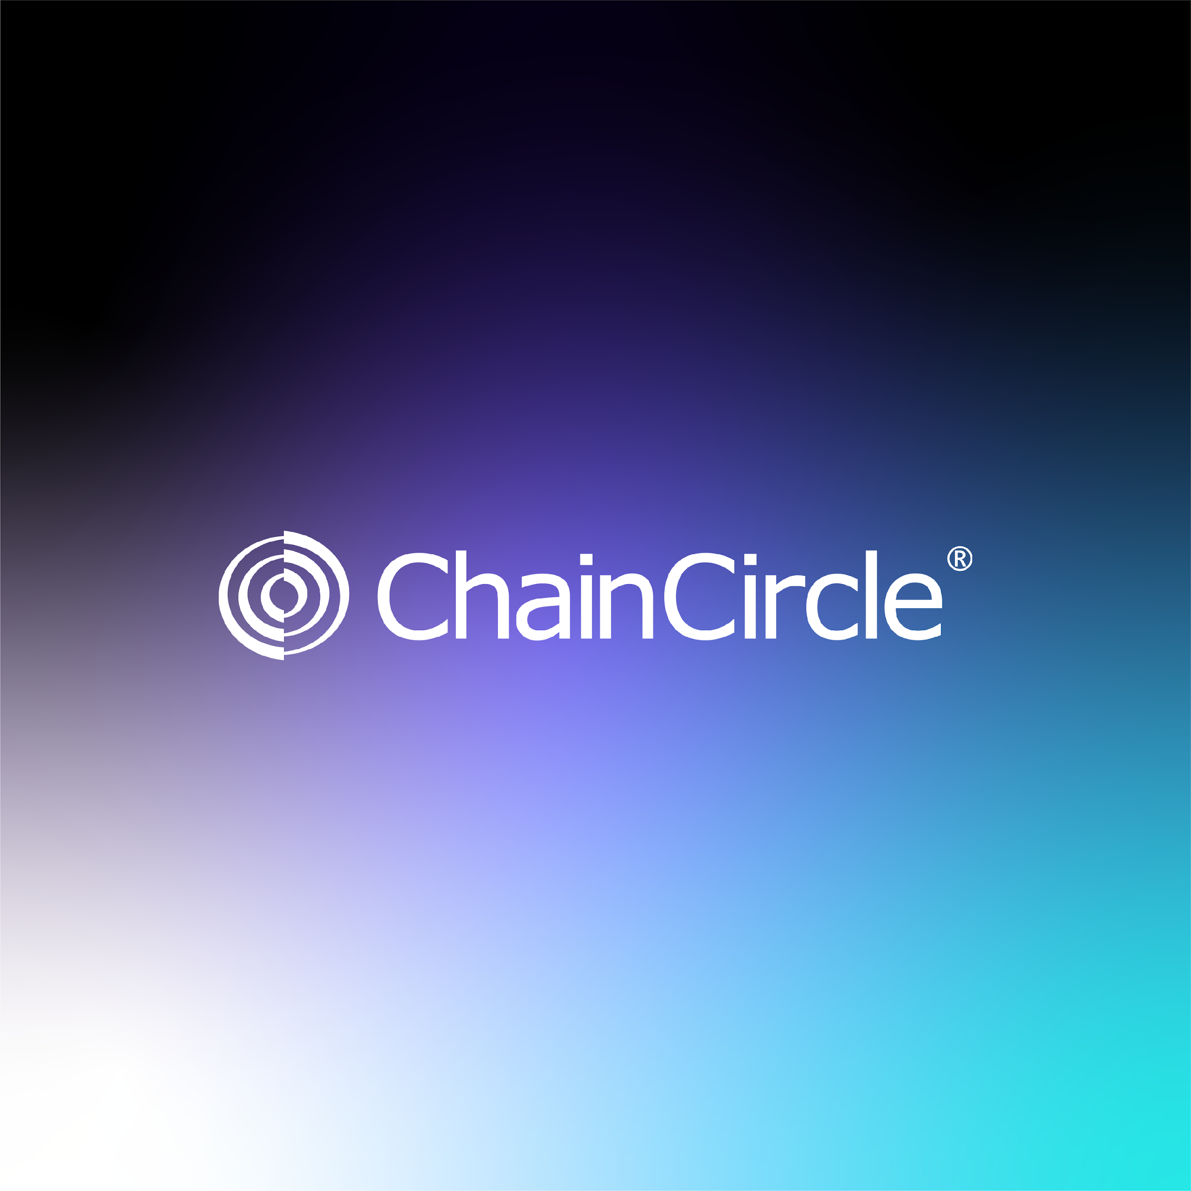

Slide 2

INTRODUCTION
The current landscape for DApp and bot development presents significant hurdles. Developers often struggle to find viable monetization channels, while users face challenges in discovering and trusting new applications.
Speed
CHAINCIRCLE
Safety
Scalability
This white paper introduces a comprehensive solution: an ecosystem that seamlessly integrates a marketplace, escrow system, and token creator, empowering developers, facilitating user discovery, and streamlining the process of token creation and distribution.
Customer Support

Slide 3

THE PROBLEM
The rise of platforms like Pump-Fun, Dex Screener, and Raydium has fueled a growing demand for bots and DApps on the Solana blockchain.
Existing marketplaces lack transparency and security, making it difficult for users to trust the authenticity of products and developers.
Talented Solana developers often struggle to find employment opportunities and showcase their skills.
Additionally, many users lack proper customer support, which can cause traders to miss investment opportunities.

Slide 4
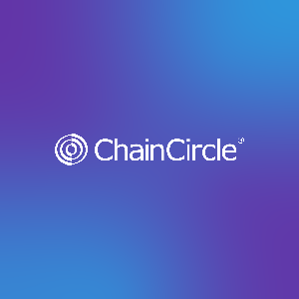
THE SOLUTION
We are building a comprehensive ecosystem for the Solana community:
A transparent and secure DApp & Bot Marketplace:
A transparent and secure dapp and bot marketplace
Developers can showcase and sell their creations
Buyers can browse,purchase and review products
An AI powered security system will screen for Malicious dapps and bots
A secure Escrow DApp:
Enables secure transactions between developers and clients worldwide.
Bypasses traditional escrow platforms, offering a more user-friendly solution.
This platform empowers new Solana developers:
Provides a platform to showcase their talent and earn income independently.
Impact:

Slide 5
WE OFFER
Increased trust and transparency
Streamline and secure trading environment for Dapps and bots

Slide 6
UNIQUE CAPABILITIES FOR USERS
Effortless Discovery: The marketplace provides a user-friendly interface for discovering and exploring a diverse range of DApps and bots, categorized and curated for easy navigation.
Community-Driven Governance: Users actively participate in shaping the ecosystem through a decentralized governance model, influencing platform development and decision-making.
Tokenized Incentives: Users earn and utilize platform-specific tokens, gaining access to exclusive benefits, premium features, and opportunities to participate in the growth of the ecosystem.

Slide 7
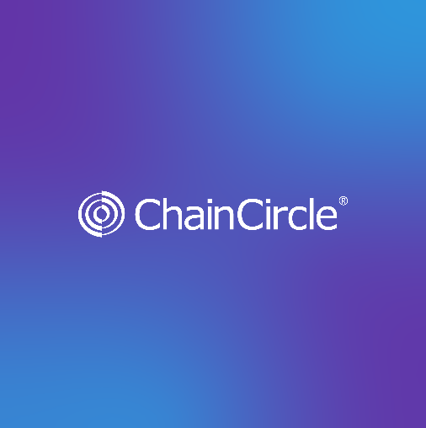
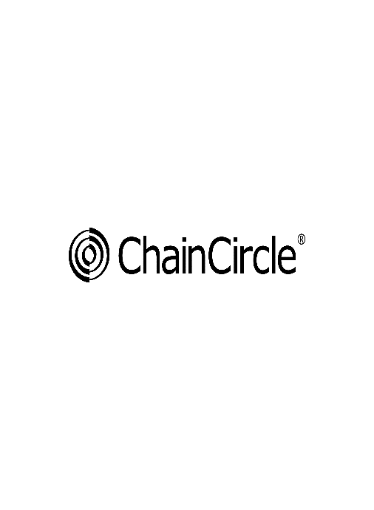
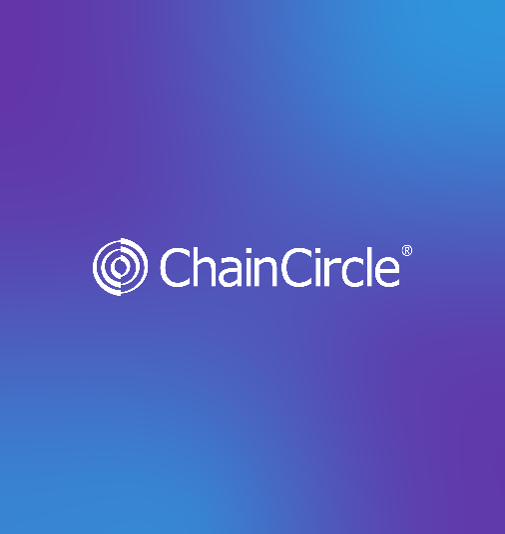
SUPPORTS PRODUCTS FROM OTHER CHAINS
Wider Selection: Users gain access to a broader range of products and services, unrestricted by the constraints of a single blockchain
Reduced Fragmentation: The platform bridges the gap between different blockchain communities, promoting collaboration and reducing the fragmentation often seen in the decentralized space.
Enhanced Innovation: By supporting products from all chains, the platform encourages developers to build and deploy innovative solutions across various networks, fostering a more dynamic and competitive environment.

Slide 8
TOKENOMICS
1B tokens total supply
5% team entry
5% foundational investors
5% pre-sales, collaborations, influencers
5% marketing
30% liquidity
50% liquidity for future DEX

Slide 9
CONCLUSION
ChainCircle is a solid project backed by an honest team that plans to revolutionize the cryptocurrency and blockchain asset exchange industry. The platform's focus on speed, safety, scalability, and customer support, combined with its innovative features and helpful resources, makes it a promising contender in the market.
Centuries earlier, in the earliest days of civilization, people exchanged goods and services through barter, which proved to be inefficient as trade grew and people traveled further to seek new markets. The invention of coins allowed for a more convenient and secure way to store and exchange value.
Centuries later, in 1800 AD, an innovative concept combined the best aspects of paper money with those of coins and it allowed central banks to create money backed by precious metals. The desire to create a better system led to the creation of Credit Cards in 1946 AD and the need for faster transactions let to the apparition of Electronic Money in 1997 AD.
Today, in 2024 AD, the world is once again ready for a more advanced, efficient, and reliable financial system. ChainCircle is well-positioned to meet these needs, leveraging the power of blockchain technology to provide a seamless and secure experience for users. The project's commitment to transparency, innovation, and customer satisfaction will no doubt contribute to its success in the years to come.

Slide 10

THANK YOU FOR LISTENING
And welcome to ChainCircle!

